Slide 1
IBSP Final Year Project Topic : Smart Office
ChengTungTing
220023779

Slide 2
BACKGROUND
BACKGROUND
The Reasons for Establishment of the Project:
The Co-working Spaces for our office
No staff identity card for attendance record
Employees need to call BMS operator to adjust the brightness and speed of office Lighting, PAU and FCU
The Problem may Caused:
Caused Low efficiency and waste time for working when staff call the operator
Obstructing and Interfering BMS Operator working
Manager or Administrator of the company difficult to know the detailed time when the staff leave and back

Slide 3
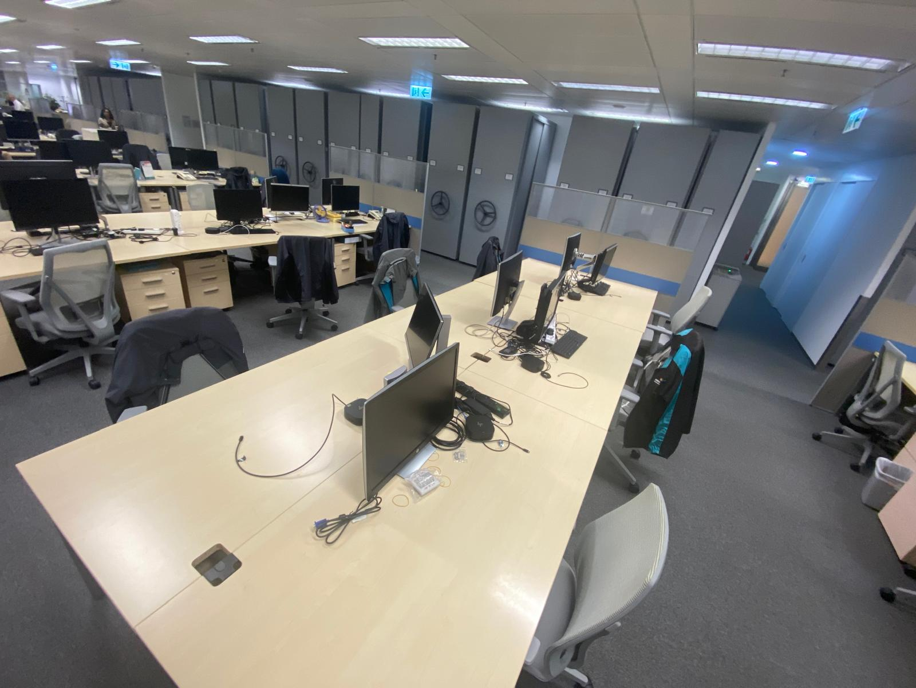
THE INTRODUCE OF THE PROJECT
The system allows employees to be identified by RFID card and face recognition at different locations.
The system automatically adjusts the devices based on employees' personal preferences
When the room's carbon dioxide concentration or temperature is too high, the PAU's fresh air supply will be automatically increased.
A website user interface to adjust the user preferences. Also, have an attendance page to record employee's attendance

Slide 4
EXPECTED BENEFIT
Improved staff satisfaction and comfort throughout the workday.
Address shortcomings and unintelligent aspects of the company's current office setup.
Resolve issues related to inconsistent lighting and air-conditioning conditions due to the co-working space.
Minimize the need for manual control of office systems by staff, reducing reliance on the BMS operator.
Enhanced user experience through a user-friendly interface for office system control.

Slide 5
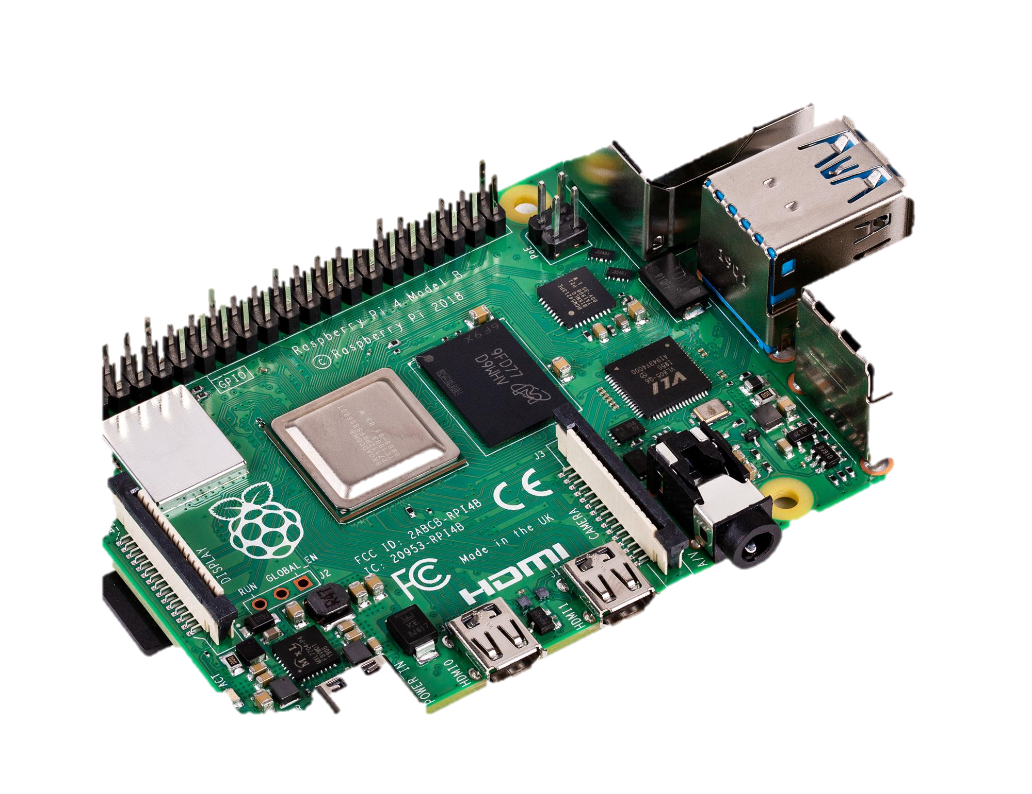
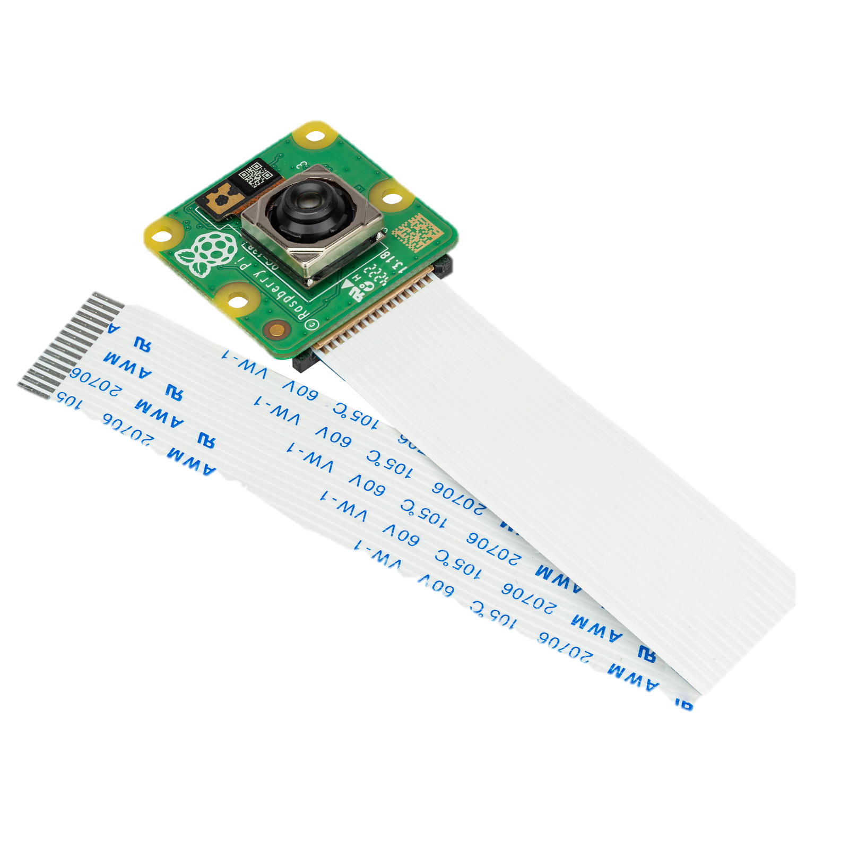
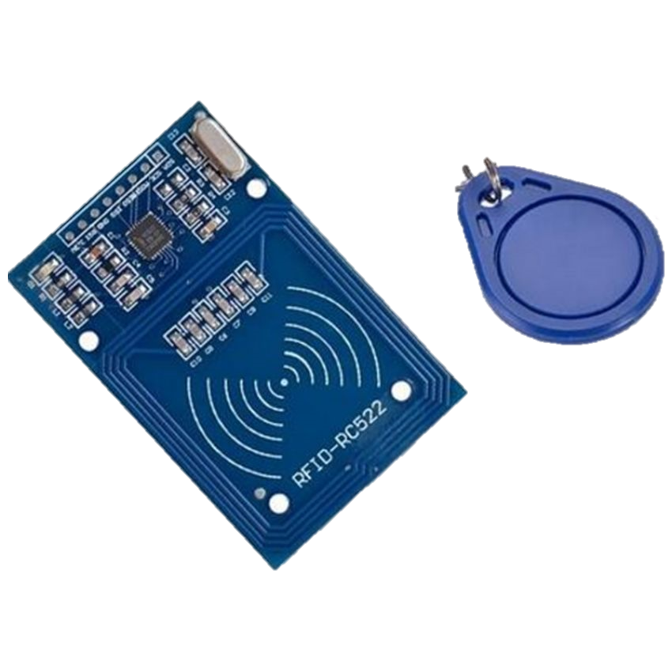
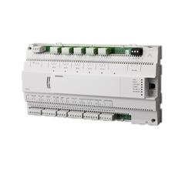

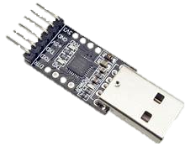
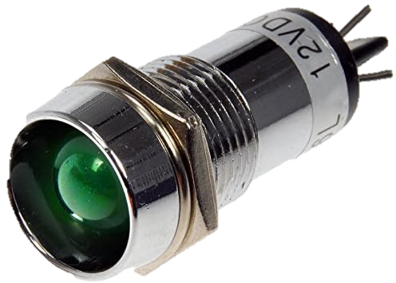
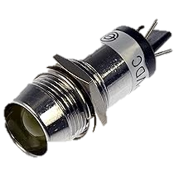
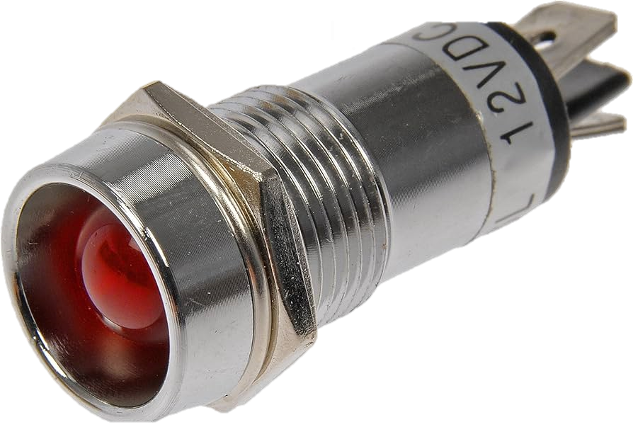
BILL OF MATERIAL
For each Zone:
Name | Amount | Function | Photo
Raspberry pi | 1 | Main controller for the systems. One zone for one raspberry pi. To control PXC24 ,RFID Reader and read camera.
Camera | 1 | For Face recognition connected to the Raspberry Pi. One camera for one raspberry pi
RFID Card and NFC RFID Reader | 1 | The RFID card as a staff identity card. The RFID Card Reader Connected to the Raspberry pi. One RFID reader and one RFID card for a raspberry pi and a staff respectively.
Siemens PXC24 Controller | 1 | The existing controller for the system, it is an actuator on this system. Two Zone used one PXC24 as actuator in order to reduce the cost.
Siemens QPA2060 Sensor | 1 | A Siemens room temperature sensor. Detect the office current temperature in °C.
Siemens QPA2000 Sensor | 1 | A Siemens Carbon dioxide Sensor. Detect the office current Carbon dioxide concentration in ppm.
USB to TTL Adaptor | 2 | Connect USB Port to TTL for the RFID Reader.
GREEN LED | 3 | Represent the speed of FCU for each zone.
YELLOW LED | 2 | Represent the brightness of Lighting for Office area.
RED LED | 2 | Represent the speed of PAU for whole Office Area.

Slide 6
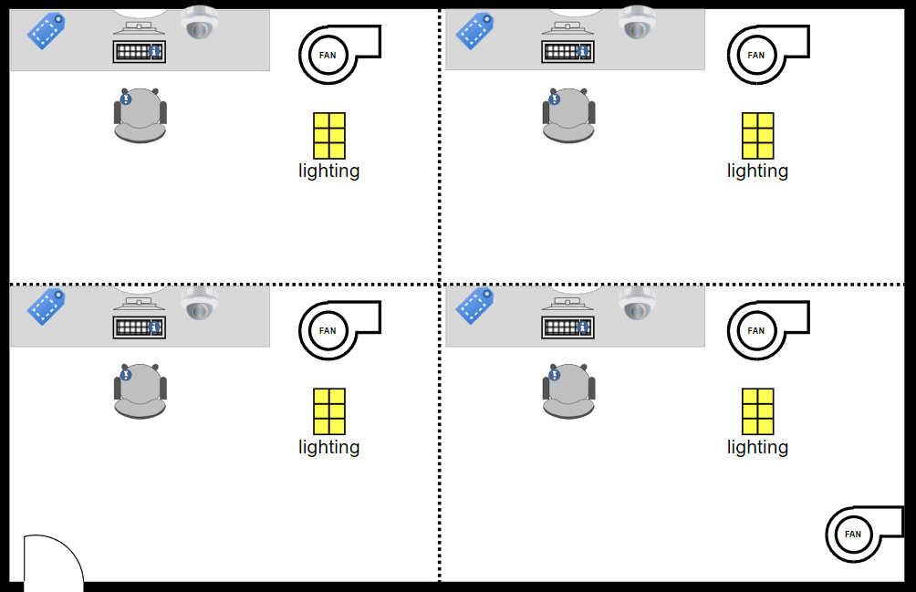
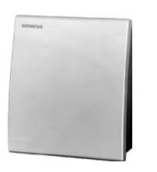
OFFICE LAYOUT
Name | Feature
Face recognition camera (A) | Detect the face for recognition and make double verification for staff login
RFID Card reader (B) | Scans staff identity card and record attendance record
Office PAU (c) | The PAU is covered the whole office and keep low speed when the any FCU is opened. The control depends on the CO2 and temperature
Temp and CO2 sensor (D) | When the sensor higher than the set point + 5% approximately (Hysteresis Protection), the PAU will turn high speed
FCU and Lighting (E) | The FCU and Lighting can be controlled on the local website and will be turn on automatically. The strength will according to the setting from website.
RFID card
reader
Face recognition
camera
RFID card
reader
Face recognition
camera
FCU Zone 1
FCU Zone 2
PXC24 Zone 1&2
Zone 1
Zone 2
RFID card
reader
Face recognition
camera
RFID card
reader
Face recognition
camera
FCU Zone 3
FCU Zone 4
PXC24 Zone 3&4
Zone 3
Zone 4
Temp & CO2 Sensor
Office PAU

Slide 7


RASPBERRY PI SIDE
External Control Raspberry Pi
Face Recognition
Request Data
Camera
Sqlalchemy
GPIO
Local Database
Selected Data from database
Analog output
Control
Siemens
PXC24
Actuator
Request Data
GPIO
HTTP Request
Rasberry Pi
Staff identity Card verification
JSON
RFID Card & RFID Card Reader(PN532)
Website user interface

Slide 8
RASBERRY PI MAIN CONTROLLER FLOW CHART
Control Zone OFF
FCU Staff A = ?
LTG Staff A = ?
FCU Staff D = ?
LTG Staff D = ?
YES
Face ID verify match with RFID
YES
YES
Start
RFID verify(Zone ON)
Staff A ?
Staff B ?
Staff C ?
Staff D ?
END
NO
YES
NO
NO
NO
NO
YES
YES
NO
LTG Staff C = ?
LTG Staff B = ?
FCU Staff C = ?
FCU Staff B = ?

Slide 9

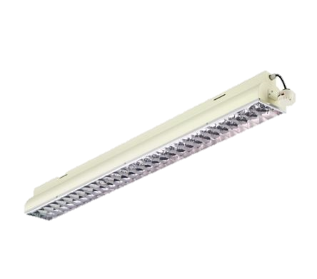

SIEMENS PXC24 SIDE
Actuator of the system
Office Primary Air Unit(PAU)
Analog Output
Analog Output
QPA2000 CO2 Sensor
Analog Input
Control
Raspberry Pi
Main Controller
Analog Output
QPA2060 Temperature Sensor
Analog Output
SIEMENS PXC24 Controller
LIGHTING
Analog Output
Fan Coil Unit(FCU)

Slide 10
SIEMNES CONTROLLER PXC24 FLOW CHART
FCU AND LIGHTING
CONTROL
FCU Staff A
= ?
FCU Staff C
= ?
LTG Staff A
= ?
LTG Staff C
= ?
YES
YES
Start
Pi signal input
YES
Staff A ?
NO
Staff B ?
NO
Staff C ?
NO
Staff D ?
NO
END
NO
YES
YES
LTG Staff B
= ?
LTG Staff D
= ?
FCU Staff B
= ?
FCU Staff D
= ?

Slide 11
SIEMNES CONTROLLER PXC24 FLOW CHART
PAU CONTROL
Sensor higher than set point +Hysteresis Protection
Start
YES
CO2 Sensor value
OR
TEMP Sensor Value
YES
PAU
High
Zone ON ?
END
NO
NO
PAU
Low
OFF

Slide 12
OPERATION FLOW
Login the Office website.
Do facial register on the register page
Open the ID card and face check page
The Fan coil, Lighting ,PAU
will run
Detect which zone the ID card has been scanned
END

Slide 13
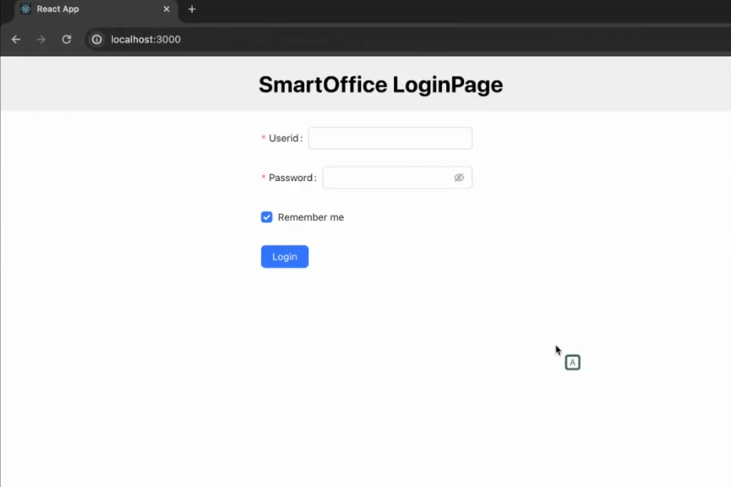
WEBSITE INTERFACE LOGIN PAGE
The User ID input and the password input.
Press remember me if user want to leave a record on this website.
Staff need to call the admin to add their account before login.

Slide 14
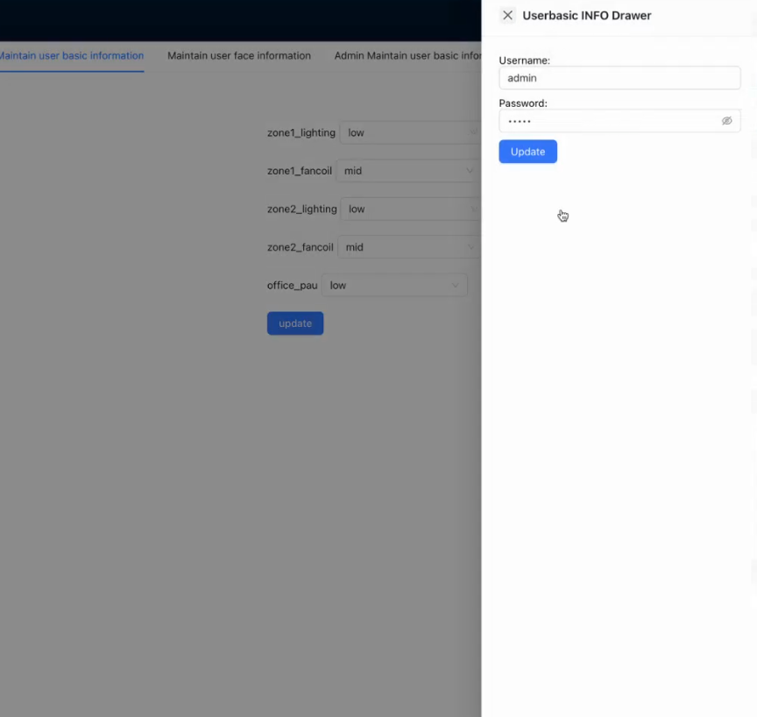
PAGE HEADER
User logout when they leave office .Pressing it will logout from the account and delete cookies from website.
Check
A button go to the Check Page
The user account ID will be displayed here
A User information edit page will jump out

Slide 15
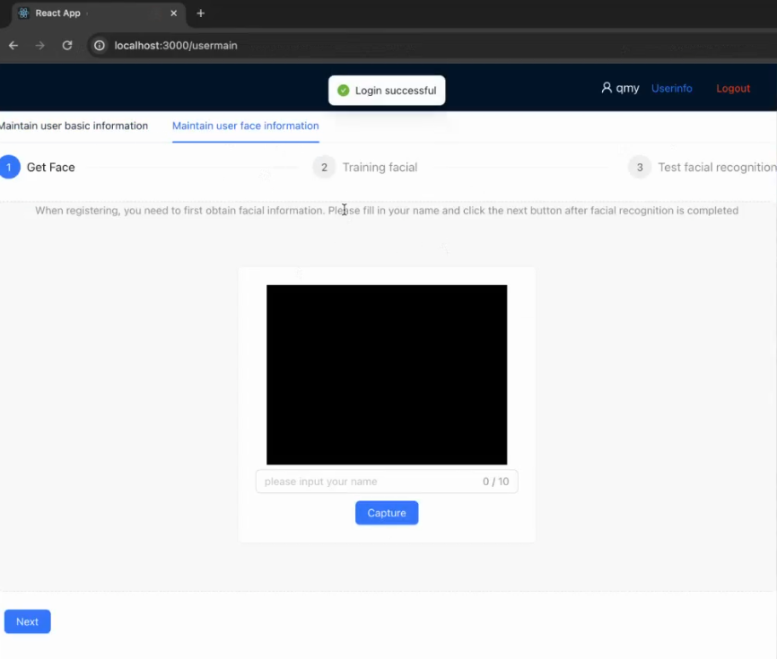
FACE RECOGNITION REGISTER PAGE
To gather face data of persons to be identified
Feed that face data and respective id’s of each face to the recognizer so that it can learn
To do a recognition test.

Slide 16
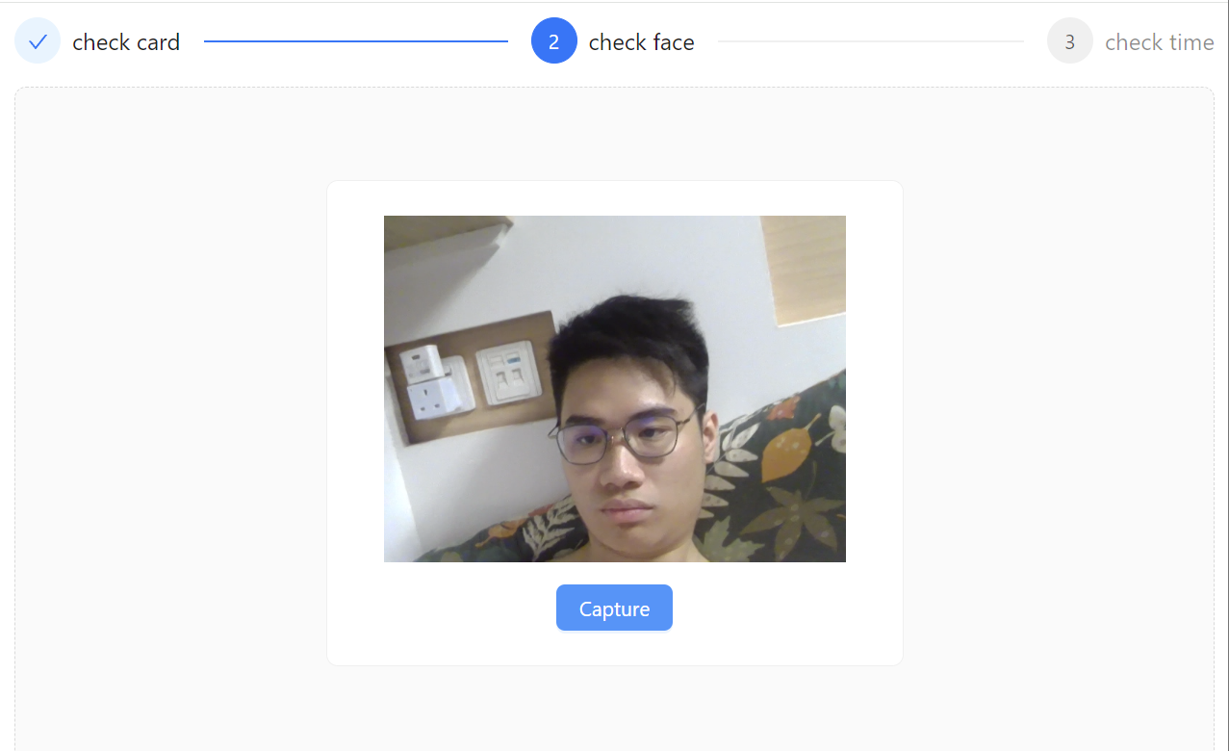
FACE AND RFID CARD CHECK PAGE
To check the card when the user press check button
To check the face match with the ID card
It will display the login time after passed the face check.

Slide 17
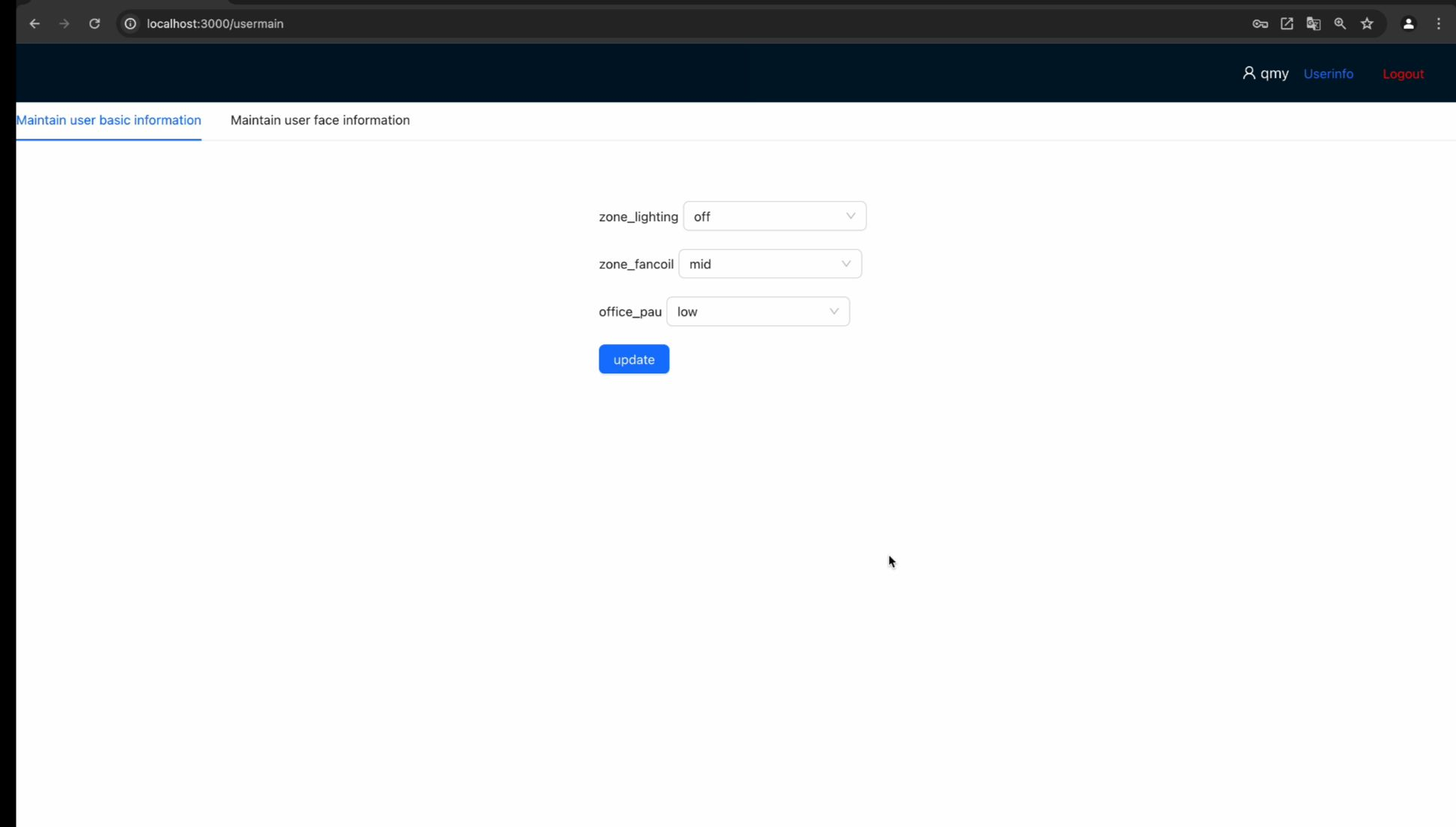
THE MAIN PAGE
Zone Lighting and FCU control. The PAU can be able to closed by administrator account

Slide 18
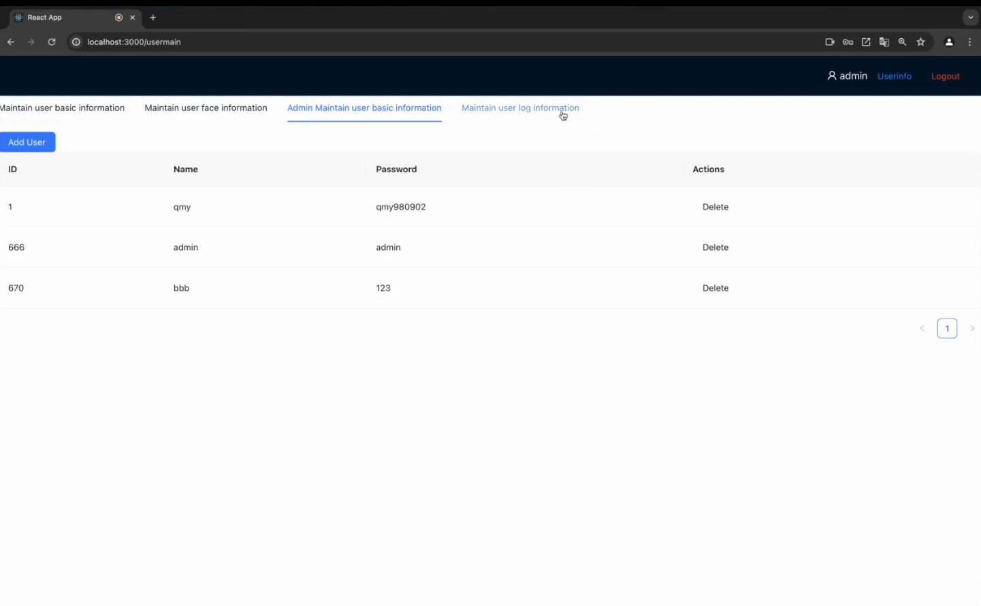
ADMINSTATOR ADD USER PAGE
To add user for a new staff
The user ID , Name and Password will display there
The delete button to remove a staff when the staff is resigned

Slide 19
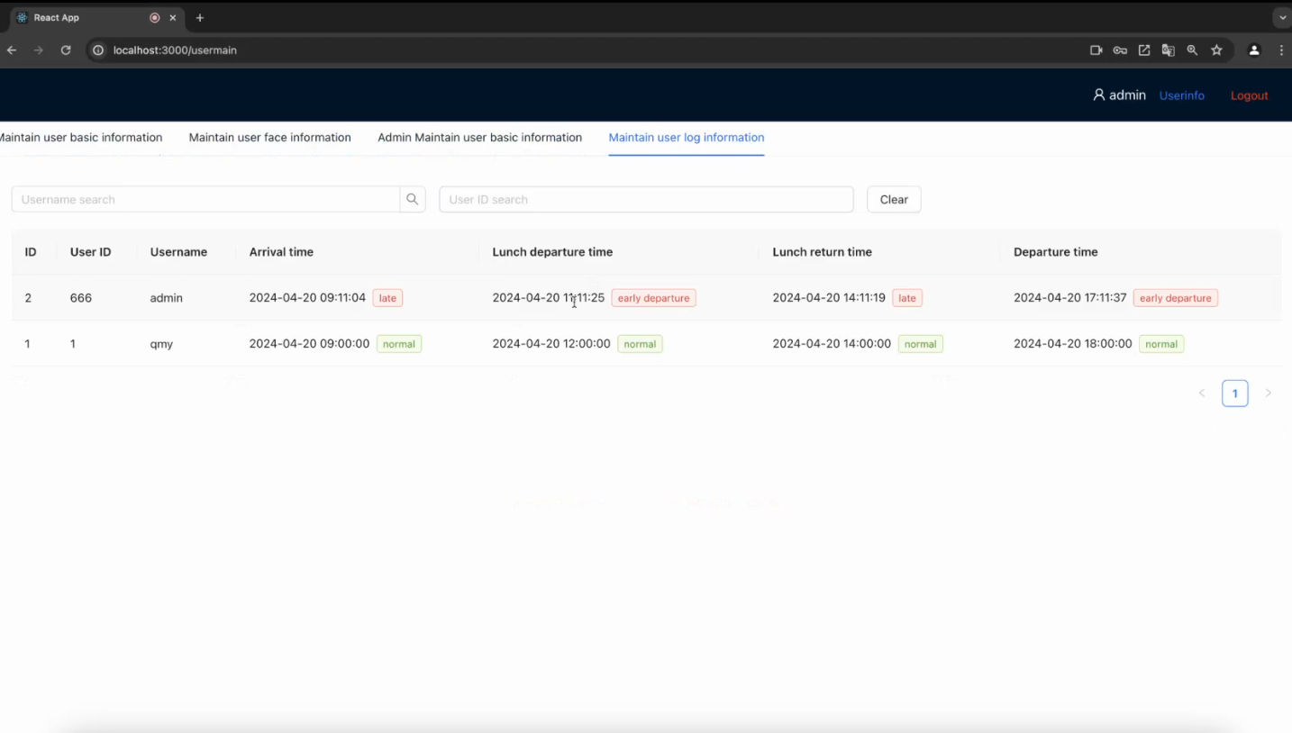
ADMINSTATION ATTENDANCE RECORD PAGE
The detailed time for staff will show there when clock on and out
It will label the time is early departure , normal or late
Name | Starting Time | Ending Time
Lunch | 12:30 | 13:30
Working | 9:00 | 18:00

Slide 20
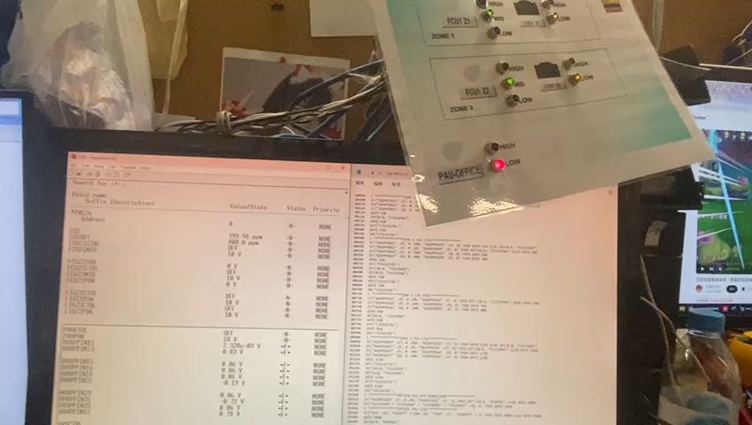
PAU Turn high from low(CO2)

Slide 21
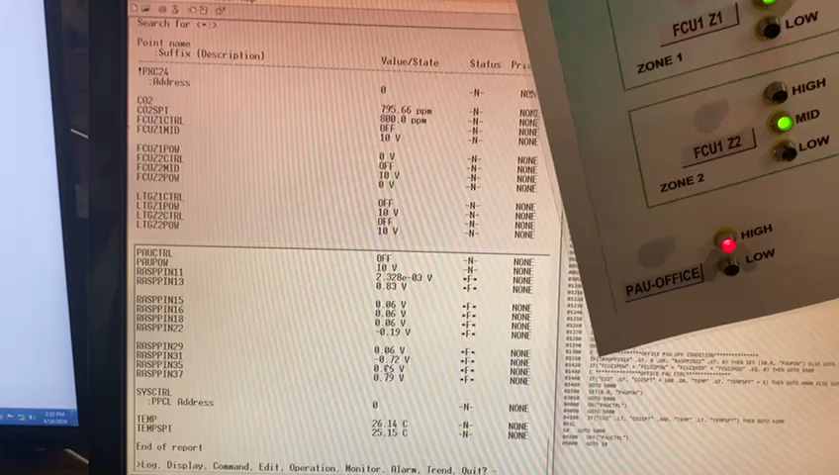
PAU Turn low from high(CO2)

Slide 22
PAU Turn high from low(Temperature)

Slide 23
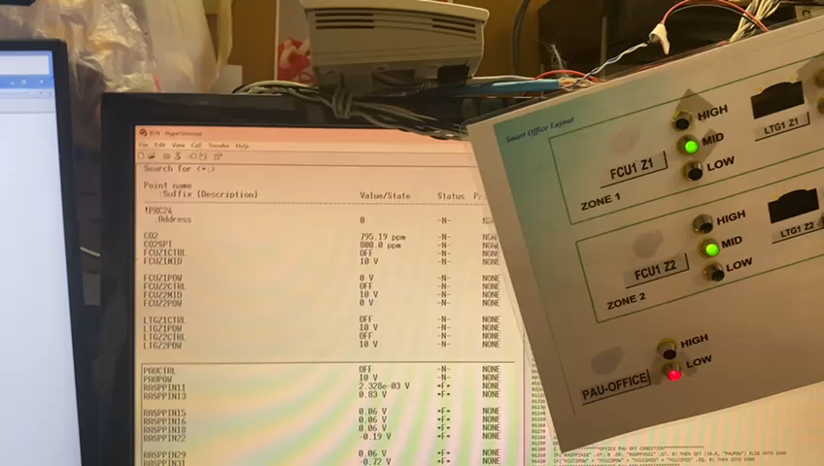
PAU Turn low from high(Temperature)

Slide 24
FUTURE DEVELOPMENT/IMPROVEMENT
Set up a timer function
Design a mobile app application and connect it to the server
Implement an insurance system for the Raspberry Pi to reduce the implication when Raspberry Pi failure
Enhance the website to include features by incorporating
To enhance the convenience for the check page

Slide 25
Q&A

Slide 26
Start
When Zone ON AND RFID verify
Control Zone OFF
RFID Verify
Face ID verify match with RFID
Staff A
Lamp Staff A
FCU Staff A
Lamp Staff B
Staff B
FCU Staff B
Staff C
Lamp Staff C
FCU Staff C
LTG Staff C
Staff D
FCU Staff C
END

Slide 27
Start
Start
Pi signal input
NO
Zone ON
Staff A ?
YES
CO2 Sensor value
Staff B ?
LTG Staff A
= ?
OR
TEMP Sensor Value
LTG Staff B
= ?
Staff C
FCU Staff A
= ?
FCU Staff B
= ?
Sensor higher than set point +1
NO
PAU(Low)
FCU Staff C
= ?
NO
Staff D
LTG Staff C
= ?
LTG Staff D
= ?
YES
PAU(High)
FCU Staff D
= ?
OFF
END
END

